Slide 1
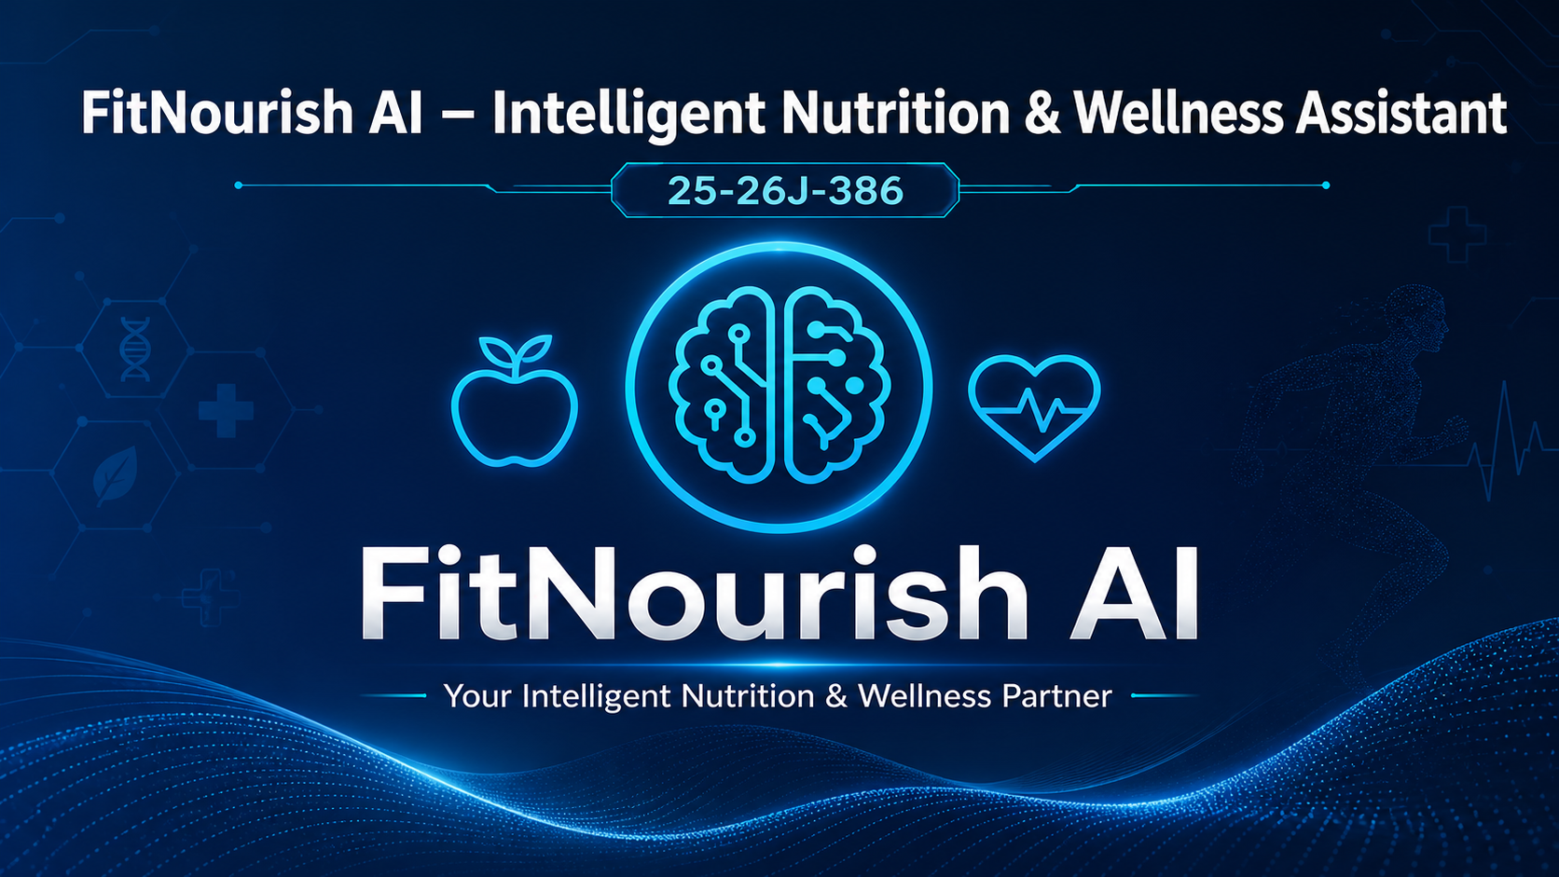

Slide 2
FitNourish AI – Intelligent Nutrition & Wellness Assistant
Student ID | IT22907684 | IT22343352 | IT22343420 | IT22343284
Panel Comment | Time management should be improved | Image dataset was not opened. Should be prepared and come to the presentations. Time management should be improved | Time management should be improved | Time management should be improved
Action Taken | Conducted advance practice sessions, improved slide flow, allocated clear speaking time to each member, and coordinated the team to complete the presentation & viva within the given time. | Pre-checked the dataset and keep a backup ready to avoid delays. Conducted practice sessions to improve time management and ensured the presentation was completed within the allocated time | reduced unnecessary explanations. Conducted practice sessions to improve time management and ensured the presentation was completed within the allocated time | reduced unnecessary explanations. Also checked the location, internet connection, and required setup beforehand to avoid delays during the presentation.

Slide 3


FitNourish AI – Intelligent Nutrition & Wellness Assistant
Problem
Current apps work separately for nutrition, meal planning, health monitoring, and grocery support. This creates a fragmented user experience and reduces personalization and low accuracy
Design Excellence
FitNourish AI integrates nutrition prediction, meal generation, food analysis, health risk tracking, smartwatch data, and grocery optimization into one unified system with high accuracy

Slide 4

IT22907684 | Weerarathne H p
AI-powered Multi-Disease Adaptive Nutrition and Personalized Health
Optimization System
Multi-Disease Adaptive Nutrition Prediction System
Trained Model: XGBoost-based Multi-Output Regression Model
The component predicts daily calories, protein, carbohydrates, and fat in a single workflow.
It is adaptive to multiple disease conditions, especially diabetes and hypertension, making the recommendations more personalized.
The model achieved an overall MAE of 19.88, showing low average prediction error.
The model achieved an overall RMSE of 44.63, indicating that large prediction deviations are also limited.
The model recorded an R² score of 0.957, which shows high explanatory power and strong overall prediction quality.
Target-wise evaluation confirmed consistent performance: Calories (R² = 0.962), Protein (R² = 0.954), Carbohydrates (R² = 0.949), and Fat (R² = 0.962).
IT22907684 | Weerarathne H P | 25-26J-386

Slide 5

IT22343352 | Ekanayake M Y R
AI – Powered Meal Plan Generator & Visual Ingredient Identifier
Personalized Meal Plan Generator
Developed a meal planning engine using Integer Linear Programming (ILP) optimized under 5 key constraints based on user profile and user preferences
calorie target, number of meals, calorie distribution, nutrient distribution, and preferred ingredients
Achieved 84% accuracy in generating daily meal plans
CNN-Based Food Analyzer
Built a CNN model for ingredient extraction, identifying 75 distinct ingredients using multi-label classification
Developed a CNN model for nutrient prediction (fat, protein, carbohydrates) through multi-task regression
Calculated calories using the 4-4-9 Atwater system rule, achieving 74% accuracy on calorie estimates
IT22343352 | Ekanayake M.Y.R | 25-26J-386

Slide 6

IT22343420 | T M Poornima
Health Progress tracking and predictive health alert system
Predictive Health Risk Classification
Trained an XGBoost classifier on 5,000 patient records with 19 physiological and lifestyle features, evaluated against Logistic Regression, Random Forest, and Gradient Boosting through 5-Fold Stratified Cross-Validation
Achieved 86.60% test accuracy with a weighted F1-score of 0.97 across Low, Medium, and High risk categories
Feature importance analysis identified cholesterol (51.42%), blood pressure (9.99%), and glucose (9.70%) as the three dominant predictors
Personalised Dietary Recommendation
Engineered 25 derived features from 17 raw health variables capturing cardiovascular risk score, metabolic risk score, and metabolic syndrome interactions, with SMOTE applied to address class imbalance
Trained and compared six models including Random Forest, Gradient Boosting, Voting Ensemble, and Stacking Ensemble through 10-Fold Stratified Cross-Validation
Achieved 66.94% test accuracy
IT22343420 | T M Poornima | 25-26J-386

Slide 7
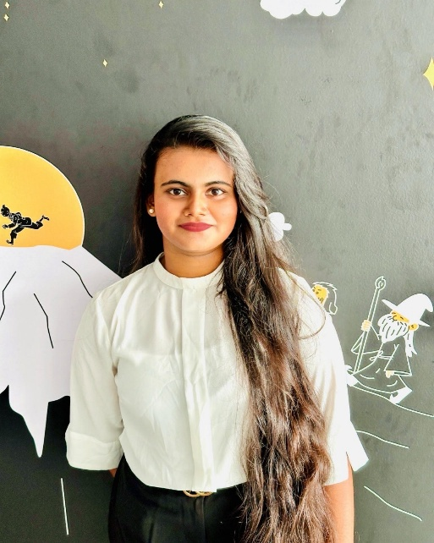
IT22343284 | SAMARAWICKRAMA T.N
AI-Powered Smart Grocery List Optimization & Nearest Store Recommendation
Developed an intelligent system to optimize grocery purchasing decisions across multiple supermarkets ( Keels , Cargills )
Implemented a machine learning–based product matching model (Random Forest) for accurate cross-store item comparison
Designed a hybrid matching approach combining rule-based, canonical mapping, and ML techniques
Used a Travelling Purchaser Problem (TPP) based method to find the most cost-effective shopping plan.
IT22343284 | Samarawickrama T.N | 25-26J-386

Slide 8
Results and Testimonials(feedback)
Positive feedback was received for the integrated idea and overall system workflow
User Acceptance Testing showed that the system is practical and useful for personalized health support
Add sugar level as input , Add health report analyzers ,Display offers in supermakets
Benchmark testing confirmed strong performance of the nutrition prediction component
Nutrition prediction achieved low MAE and RMSE with a high R² score
Health risk prediction showed good classification performance using Accuracy and F1-score
Limitations
Current supermarket coverage is limited to selected retailers.
The current system mainly supports two disease conditions: diabetes and hypertension
Some ingredients used in generated meal plans are not commonly available in Sri Lankan
supermarkets
Future Work
Extend the system to support more diseases and health conditions
Improve meal generation by aligning recipes with Sri Lankan
supermarket availability
add more supermarkets, improve visual recognition, integrate more wearable devices
.

Slide 9


